Slide 1


Presentation on: Preliminary Project Report
A research and development based project…
Notes:
NOTE:
To change the image on this slide, select the picture and delete it. Then click the Pictures icon in the placeholder to insert your own image.

Slide 2

Presented by-
M. A. Nur Quraishi
Roll: BSSE-0615
BSSE 6th Batch
IIT, DU
Supervised by-
Rayhanur Rahman
Lecturer at
IIT, DU

Slide 3
Project Name
Recovering Documentation-to-Source-Code Traceability Links using Latent Semantic Indexing

Slide 4
Contents
Feedback of Previous Presentation
Methodology
Evaluation and Analysis
Achievements
Question Session

Slide 5
Feedback of Previous Presentation
What is Vector Space?
is also known as linear space consists of a set of objects named vectors
can be added with each other and multiplied by numbers named scalars
scalars can be-
real numbers
complex numbers
rational numbers
must fulfill certain set of axioms-
must demonstrate physical quantities or measures (like - Force)
can be added together to produce a third one
result of multiplication is another force vector
illustrate displacements (vector with direction and magnitude) in the plane or in three-dimensional space
infinite-dimension may arise in mathematical analysis as function spaces
Example: Euclidean space, Banach spaces and Hilbert spaces

Slide 6
Feedback of Previous Presentation (Continued)
Figure: Geometric view of vector space.

Slide 7
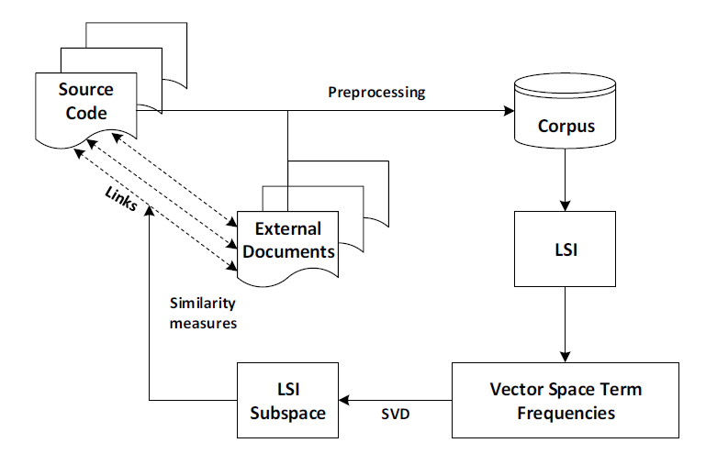
Methodology

Slide 8
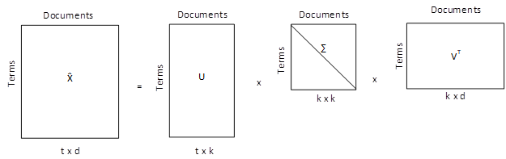
Methodology (Continued)
Figure: Singular Value Decomposition
Similarity measure = cos (x, y) = $\sqrt{\frac{x^{T}y}{{|x|}_{2 }∗ {|y|}_{2}}}$
Click here for more details

Slide 9

Evaluation and Analysis
used two evaluation matrices or measures
Precision:
Precision = $\frac{C_{i}}{N_{i}}$ = $\frac{\# (correct \bigcap{recovered})}{\# recovered}$ x 100%
Recall:
Recall = $\frac{C_{i}}{R_{i}}$ = $\frac{\# (correct \bigcap{recovered})}{\# correct}$ x 100%

Slide 10
Evaluation and Analysis (Continued)
Evaluation for Braille to Text Translator:
Table: Elements of the Braille to Text Translator source code, SRS and LSI settings.
Element name | Number of elements
Source code files | 64
SRS sections | 50
Total documents | 114
Vocabulary | 1530
LSI dimension used | 200 - 400

Slide 11
Evaluation and Analysis (Continued)
Table: Recovered links, recall, precision, similarity result using different threshold for the Braille to Text Translator.
Cosine threshold | Correct links retrieved | Incorrect links retrieved | Total links recovered | Precision | Recall | Similarity result
0.05 | 56 | 145 | 201 | 27.86 % | 88.89 % | 87 %
0.07 | 43 | 38 | 81 | 53.09 % | 68.25 % | 62 %
0.10 | 15 | 2 | 17 | 88.24 % | 23.81 % | 20 %

Slide 12
Evaluation and Analysis (Continued)
Figure: Precision and recall graph for Braille to Text Translator

Slide 13
Evaluation and Analysis (Continued)
Evaluation for BD Travelers:
Table: Elements of the BD Travelers source code, SRS and LSI settings.
Element name | Number of elements
Source code files | 21
SRS sections | 11
Total documents | 32
Vocabulary | 1190
LSI dimension used | 200 - 400

Slide 14
Evaluation and Analysis (Continued)
Table: Recovered links, recall, precision, similarity result using different threshold for the BD Travelers.
Cosine threshold | Cosine threshold | Correct links retrieved | Incorrect links retrieved | Total links recovered | Precision | Recall | Similarity result
0.05 | 0.05 | 15 | 20 | 35 | 42.86 % | 75 % | 57 %
0.07 | 0.07 | 6 | 5 | 11 | 54.55 % | 28.57 % | 38 %
0.10 | 0.10 | 1 | 0 | 1 | 100% | 4.76% | 4%

Slide 15
Evaluation and Analysis (Continued)
Figure: Precision and recall graph for BD Travelers

Slide 16
Achievements
Implementation of an existing project
New experience and knowledge about textual analysis and cosine similarity
A complete Web-based application

Slide 17

Question Session

Slide 18
Thank You!!!

